Slide 1
ANALYSIS STUDY OF VIRTUAL PRIVATE NETWORK ON CISCO 1841 ROUTER
IWAN CHANDRA
207115684

Slide 2
Main Points
Backgrounds
Objective
Scope
Virtual Private Network
IPSec
Analysis Result
Implementation on ADSL
Conclusion

Slide 3
Backgrounds
The need for a network that provides privacy between the two networks
The use of a comparatively cheap Internet cost, but insecure
Many methods of VPN implementation

Slide 4
Objective
Implementing VPN to establish a private network on a Wide Area Network using Cisco 1841 Router and ADSL Connection.
Analyze the security system and performance between networks using VPN to a network without a VPN.

Slide 5
Scope
Use Cisco 1841 as VPN Gateway and IPsec as Security Protocol
Implementing ADSL Connection for the case study
Analyzing the security of VPN combination using a Simulated WAN

Slide 6
What is VPN?
VPN is a technology for using the Internet or another intermediate network to connect computers to isolated remote computer networks that would otherwise be inaccessible. A VPN provides security so that traffic sent through the VPN connection stays isolated from other computers on the intermediate network.

Slide 7
Why use VPN?
Cheaper than building a private line
Provides security as a private line does
Ease in network expansion
Compatible with existing broadband technologies

Slide 8
VPN Protocols
PPTP – Point to Point Tunneling Protocol
L2TP – Layer 2 Tunneling Protocol
MPLS – Multi Protocol Label Switching
IPsec – Internet Protocol Security

Slide 9
IPsec
Internet Protocol Security (IPsec) is a protocol suite for securing Internet Protocol (IP) communications by authenticating and encrypting each IP packet of a communication session. IPsec also includes protocols for establishing mutual authentication between agents at the beginning of the session and negotiation of cryptographic keys to be used during the session.

Slide 10
IPsec Components
IPsec Protocol
Confidentiality
Integrity
Authentication
Diffie-Hellman

Slide 11
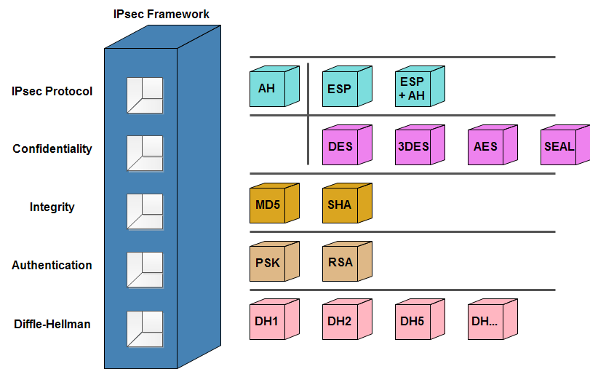
Why IPsec?
Have a security framework that can be modified in accordance with the desired security requirements.

Slide 12
Why IPsec?
Easier implementation than other protocols
Supports all existing modes

Slide 13
How IPsec works?

Slide 14
How IPsec works?
IPsec encrypt the original package which contain IP Header and Data, then added with ESP trailer

Slide 15
How IPsec works?
By adding a new ESP Header, the encrypted package encapsulated to a new package.

Slide 16
How IPsec works?
The ESP package sent with New IP Header which contains gateway sender’s IP and receiver’s IP, and authenticated with ESP authentication.

Slide 17
How IPsec works?
The receiver decrypt the ESP package with encryption and hash algorithm which has been negotiated before building the IPsec tunnel.

Slide 18
Implementation on ADSL
ADSL Connection implemented using 2 different methods:
Add an WIC-1ADSL module on Cisco 1841
Bridged Connection

Slide 19
Implementation on ADSL
On STTS side:
Create a Virtual Private Dialer Network
Configure Interface Fa0/1 as WAN Interface
Configure Dialer Interface
Configure ISP Credential
Configure Routing
Configure IPsec components and transform set
Define Access Control List
Applying Crypto Map

Slide 20
Implementation on ADSL
On Remote side:
Add WIC-1ADSL module on Cisco 1841
Configure ADSL Interface
Configure Dialer Interface and ISP Credential
Configure Default Route and NAT
Configure IPsec components and transform set
Define Access Control List
Applying Crypto Map

Slide 21
Analysis Result
No | Auth | Encr | Hash | 0 Router Pass | 2 Router Pass | 6 Router Pass
 |  |  |  | PING | PING | PING
0 | No VPN |  |  | 1 | 18 | 87
 |  |  |  | 1 | 18 | 87
 |  |  |  | 1 | 18 | 87
1 | PSK | DES | SHA | 2 | 33 | 155.5
 |  |  |  | 1.5 | 33.5 | 168.5
 |  |  |  | 2 | 33 | 164
2 | PSK | DES | MD5 | 2 | 33 | 155
 |  |  |  | 2 | 35 | 158
 |  |  |  | 2 | 33 | 157.5
3 | PSK | 3DES | SHA | 2 | 33 | 155.5
 |  |  |  | 1.5 | 33 | 154.5
 |  |  |  | 2 | 32.5 | 155
4 | PSK | 3DES | MD5 | 2 | 32 | 155.5
 |  |  |  | 2 | 33 | 159
 |  |  |  | 1.5 | 33 | 155
5 | PSK | AES | SHA | 2 | 35 | 165.5
 |  |  |  | 1.5 | 35.5 | 166.5
 |  |  |  | 2 | 35 | 165.5
6 | PSK | AES | MD5 | 2 | 35 | 166
 |  |  |  | 2 | 35 | 166
 |  |  |  | 1.5 | 35 | 165.5

Slide 22
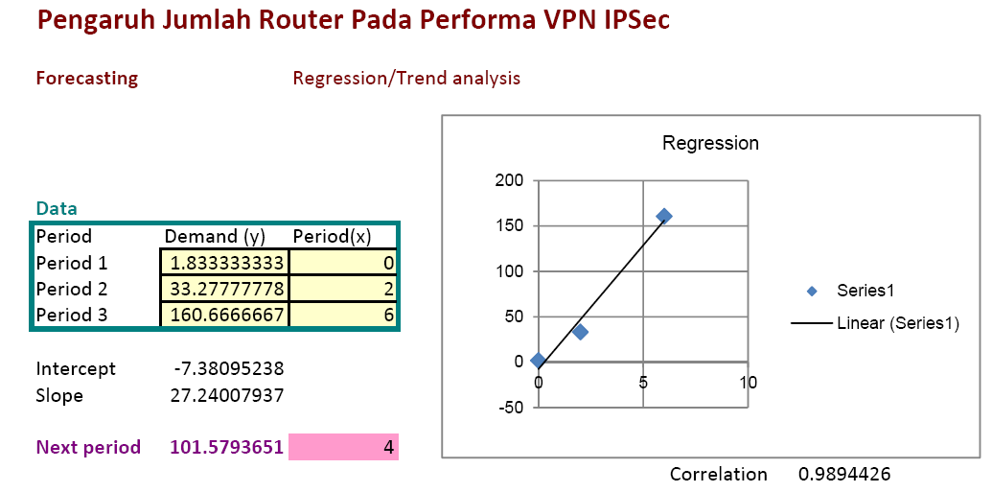
Analysis Result
From the result table, and use a simple linear regression, can be summarized an equation which show the relation between router on WAN, with performance of VPN Connection made.
Y = -7.38 + 27.24(X)

Slide 23
Analysis Result
Y = -7.38 + 27.24(X)
Y = PING Performance
X = Router Passed on WAN

Slide 24
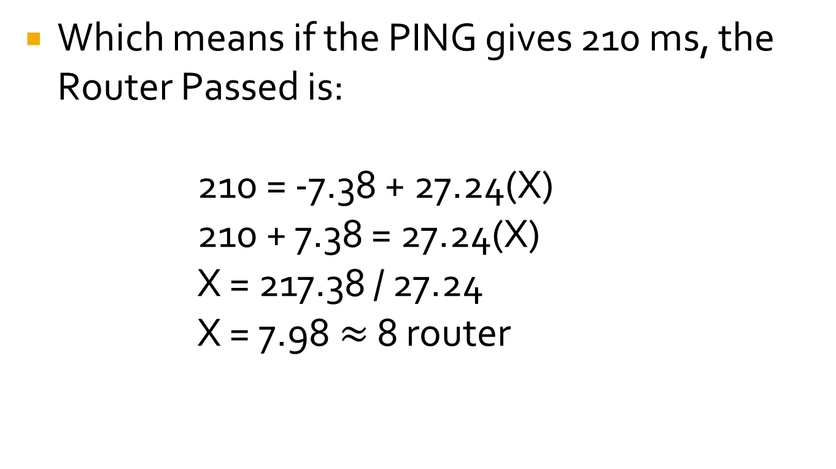
Analysis Result
Which means if the PING gives 210 ms, the Router Passed is:
210 = -7.38 + 27.24(X)
210 + 7.38 = 27.24(X)
X = 217.38 / 27.24
X = 7.98$≈$ 8 router

Slide 25
Conclusion
Router sum on WAN affect the VPN Performance
Encryption and hash method doesn’t affect VPN performance significantly
VPN can implemented on ADSL using Cisco 1841 with WIC-1ADSL module or Bridged Connection

